Slide 1
Natural Language Processing
CSCI 5832 – Lecture 22
Jim Martin

Slide 2
Today
Wrap up First Order Logic
Information extraction
Sequence labeling for Named Entities
Classifiers & RNNs
Relation extraction

Slide 3
Models
Consider
Everyone likes a noisy restaurant
First what the heck does this mean?

Slide 4
Models
There is a particular restaurant out there; it’s a noisy place; everybody likes it
Everbody likes The Med.
Everybody has at least one noisy restaurant that they like
Everbody has a favorite noisy restaurant.
Everybody likes noisy restaurants (i.e., there is no noisy restaurant out there that is disliked by anyone)
Everybody loves a cute puppy

Slide 5

Models
Let’s assume # 2 is the one we want...
Is this true given our model?

Slide 6
Restaurant World

Slide 7
Models
Nope. Does the Rio like a noisy restaurant?
The forall operator really means forall. Not forall the things that you think it ought to mean forall for.
So this formulation is wrong
It’s wrong it two related ways...
We need categories
people and restaurants
And the connective (^) is wrong

Slide 8

Categories as Properties
Properties
Noisy | {e,f,g}
Restaurant | {e,f,g}
Person | {a,b,c,d}

Slide 9

Note
It’s important to see why this works.
It’s not the case the the \forall is only looping over all the people based on some category (or type).
\forall still means \forall
As in...

Slide 10
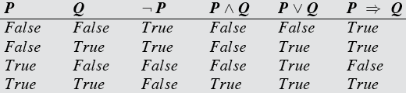
Note
What happens to an “implies” formula when P is false?

Slide 11
Back to Categories
Using predicates to create categories of concepts is a pretty rudimentary approach
Description logics are the primary modern way to
Reason about categories
And individuals with respect to categories
They are the basis for OWL (Web Ontology Language) which in turn is the basis for most work on the Semantic Web

Slide 12
Information Extraction
Ordinary newswire text is often used in typical examples.
And there are lots of useful applications out there
But the real interest/money is in specialized domains
Bioinformatics
Electronic medical records
Stock market analysis
Intelligence analysis
Social media

Slide 13
Information Extraction
CHICAGO (AP) — Citing high fuel prices, United Airlines said Friday it has increased fares by $6 per round trip on flights to some cities also served by lower-cost carriers. American Airlines, a unit AMR, immediately matched the move, spokesman Tim Wagner said. United, a unit of UAL, said the increase took effect Thursday night and applies to most routes where it competes against discount carriers, such as Chicago to Dallas and Atlanta and Denver to San Francisco, Los Angeles and New York

Slide 14
Information Extraction
CHICAGO (AP) — Citing high fuel prices, United Airlines said Friday it has increased fares by $6 per round trip on flights to some cities also served by lower-cost carriers. American Airlines, a unit AMR, immediately matched the move, spokesman Tim Wagner said. United, a unit of UAL, said the increase took effect Thursday night and applies to most routes where it competes against discount carriers, such as Chicago to Dallas and Atlanta and Denver to San Francisco, Los Angeles and New York.
Notes:
Entitites

Slide 15
Information Extraction
CHICAGO (AP) — Citing high fuel prices, United Airlines said Friday it has increased fares by $6 per round trip on flights to some cities also served by lower-cost carriers. American Airlines, a unit AMR, immediately matched the move, spokesman Tim Wagner said. United, a unit of UAL, said the increase took effect Thursday night and applies to most routes where it competes against discount carriers, such as Chicago to Dallas and Atlanta and Denver to San Francisco, Los Angeles and New York.
Organizations | People | Places
United Airlines | Tim Wagner | Chicago
American Airlines |  | Dallas
AMR |  | Atlanta
UAL |  | Denver
 |  | San Francisco
 |  | Los Angeles
 |  | New York
Notes:
Entitites

Slide 16
Information Extraction
CHICAGO (AP) — Citing high fuel prices, United Airlines said Friday it has increased fares by $6 per round trip on flights to some cities also served by lower-cost carriers. American Airlines, a unit AMR, immediately matched the move, spokesman Tim Wagner said. United, a unit of UAL, said the increase took effect Thursday night and applies to most routes where it competes against discount carriers, such as Chicago to Dallas and Atlanta and Denver to San Francisco, Los Angeles and New York
Notes:
relations

Slide 17
Information Extraction
CHICAGO (AP) — Citing high fuel prices, United Airlines said Friday it has increased fares by $6 per round trip on flights to some cities also served by lower-cost carriers. American Airlines, a unit AMR, immediately matched the move, spokesman Tim Wagner said. United, a unit of UAL, said the increase took effect Thursday night and applies to most routes where it competes against discount carriers, such as Chicago to Dallas and Atlanta and Denver to San Francisco, Los Angeles and New York
Notes:
Events

Slide 18
Information Extraction
CHICAGO (AP) — Citing high fuel prices, United Airlines said Friday it has increased fares by $6 per round trip on flights to some cities also served by lower-cost carriers. American Airlines, a unit AMR, immediately matched the move, spokesman Tim Wagner said. United, a unit of UAL, said the increase took effect Thursday night and applies to most routes where it competes against discount carriers, such as Chicago to Dallas and Atlanta and Denver to San Francisco, Los Angeles and New York
Notes:
Amounts, dates, measures, etc.

Slide 19
Information Extraction
CHICAGO (AP) — Citing high fuel prices, United Airlines said Friday it has increased fares by $6 per round trip on flights to some cities also served by lower-cost carriers. American Airlines, a unit AMR, immediately matched the move, spokesman Tim Wagner said. United, a unit of UAL, said the increase took effect Thursday night and applies to most routes where it competes against discount carriers, such as Chicago to Dallas and Atlanta and Denver to San Francisco, Los Angeles and New York

Slide 20
Named Entity Recognition
Find and classify all the named entities in a text.
What’s a named entity?
A reference to an entity via the mention of its name.
Colorado Rockies
This is a subset of the possible mentions...
Rockies, the team, it, they...
Find means identify the exact span of the mention.
Classify means determine the category of the entity being referred to.

Slide 21
Statistical Sequence Labeling
We can treat NER as a per-word tagging task
Recall with POS tagging we trained systems to tag words using annotated training data
Training data
Hand tag a bunch of data with POS tags
Training
HMMs
Logistic regression
Neural networks

Slide 22
From Tags to Spans
So how do we use word-by-word tagging to find and classify spans of text (like named entities)?
We’ll use what’s called IOB encoding
I -> Inside ; this word is inside a span
O -> Outside ; outside a span of interest
B -> Begin ; begins a span

Slide 23
IOB Encoding (NER)
For each kind of entity, we’ll have a specific I and and B tag
B_loc, B_person, B_protein, B_org, B_location
One general O tag
Giving us 2*N + 1 kinds of tags
Tags are the labels that a supervised learner has to learn to emit on a per-word basis

Slide 24
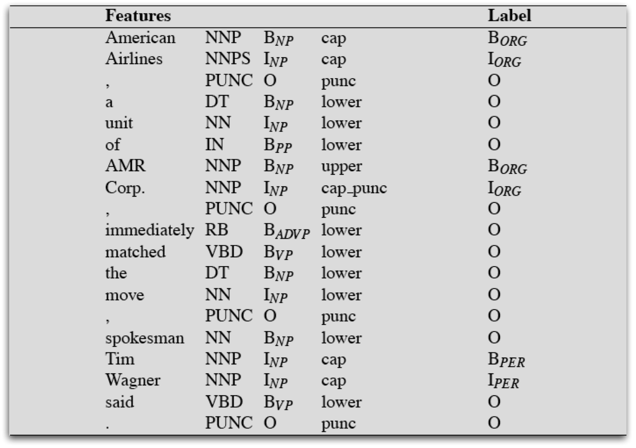
NER Training Data

Slide 25
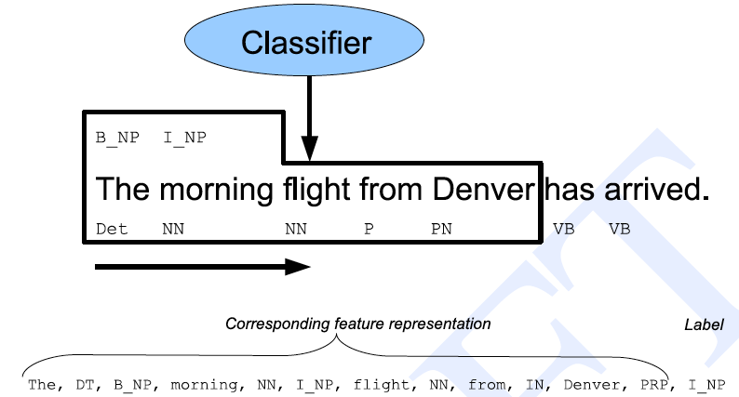
Statistical Sequence Labeling

Slide 26
Typical Features
Typical ML setup involves
A sliding window around the sequence element being tagged
Features extracted from the window
Current word token
Previous/next N word tokens
Current word POS
Previous/next POS
Capitalization information
...

Slide 27
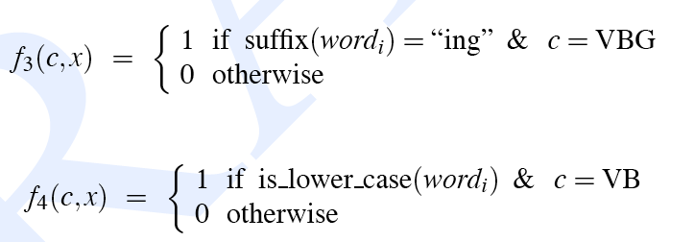
Features

Slide 28
Features

Slide 29
NER Features
The usefulness of particular features varies by domain and by language
But features should be superficial and easily extracted from the text to be analyzed
Can’t solve a problem by using a feature that’s harder to extract than the actual problem!
The “shape” feature turns out to be amazingly useful in many domains

Slide 30
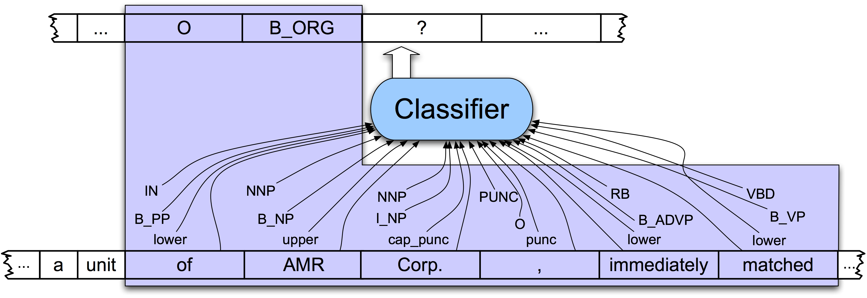
NER as Sequence Labeling

Slide 31
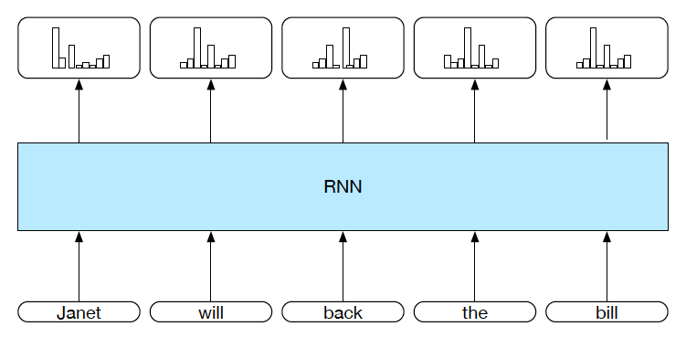
RNN Sequence Labeling

Slide 32
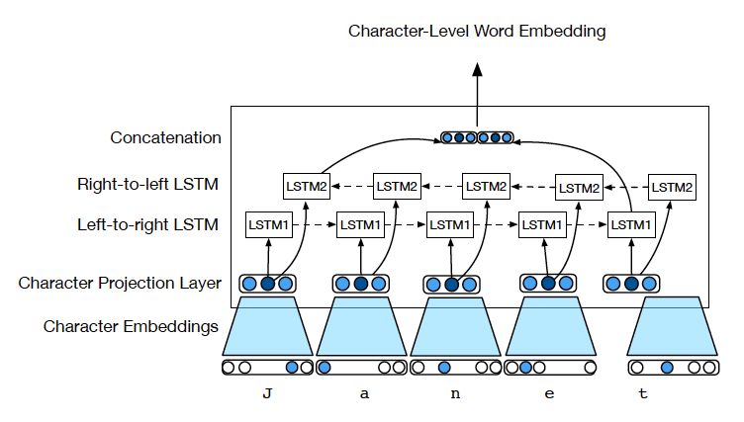
Generating Character-Level Embeddings

Slide 33
Problem
Both the classical ML approach and the RNN approach tag each word in isolation
They don’t explicitly attempt to argmax the most probable sequence.
Don’t even guarantee a well-formed tag sequence.
Nothing prevents them from emitting an I_per after an O or after an I_org

Slide 34
Answer
Add a language model onto the sequential classification scheme.
Instead of having the classifier emit one label as an answer for each object, use the softmax distribution over the labels for each word
Train a language model for the kinds of sequences we’re trying to produce.
Run Viterbi over the label distributions for the sequence to get the best overall sequence

Slide 35
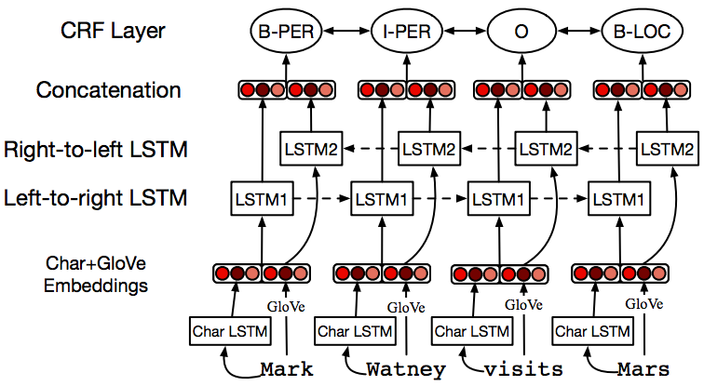
CRF/RNN Model

Slide 36
NER Evaluation
It is a bad idea to evaluation sequence labelers at the tag level.
Most labels are O; so just guessing O gives a learning algorithm a lot of credit.
So we need to evaluate precision, recall and F at the entity level.
But we may not care equally about all kinds of entities
So we might weight them differently in our evaluation.

Slide 37
NER Related Tasks
Arbitrary entity references
“Colorado’s MLB team”
Entity linking
Linking an entity mention to a database or KB of non-ambiguous entries
Wikification
“Rockies” →
https://en.wikipedia.org/wiki/Colorado_Rockies
https://en.wikipedia.org/wiki/Colorado_Rockies_(NHL)
https://en.wikipedia.org/wiki/Rocky_Mountains
https://en.wikipedia.org/wiki/Blackrock_GAA

Slide 38
Relations
Once you have captured the entities in a text, you might want to ascertain how they relate to one another.
Here we’re just talking about relations explicitly stated within a text – not ones that can be inferred.

Slide 39
Information Extraction
CHICAGO (AP) — Citing high fuel prices, United Airlines said Friday it has increased fares by $6 per round trip on flights to some cities also served by lower-cost carriers. American Airlines, a unit AMR, immediately matched the move, spokesman Tim Wagner said. United, a unit of UAL, said the increase took effect Thursday night and applies to most routes where it competes against discount carriers, such as Chicago to Dallas and Atlanta and Denver to San Francisco, Los Angeles and New York

Slide 40
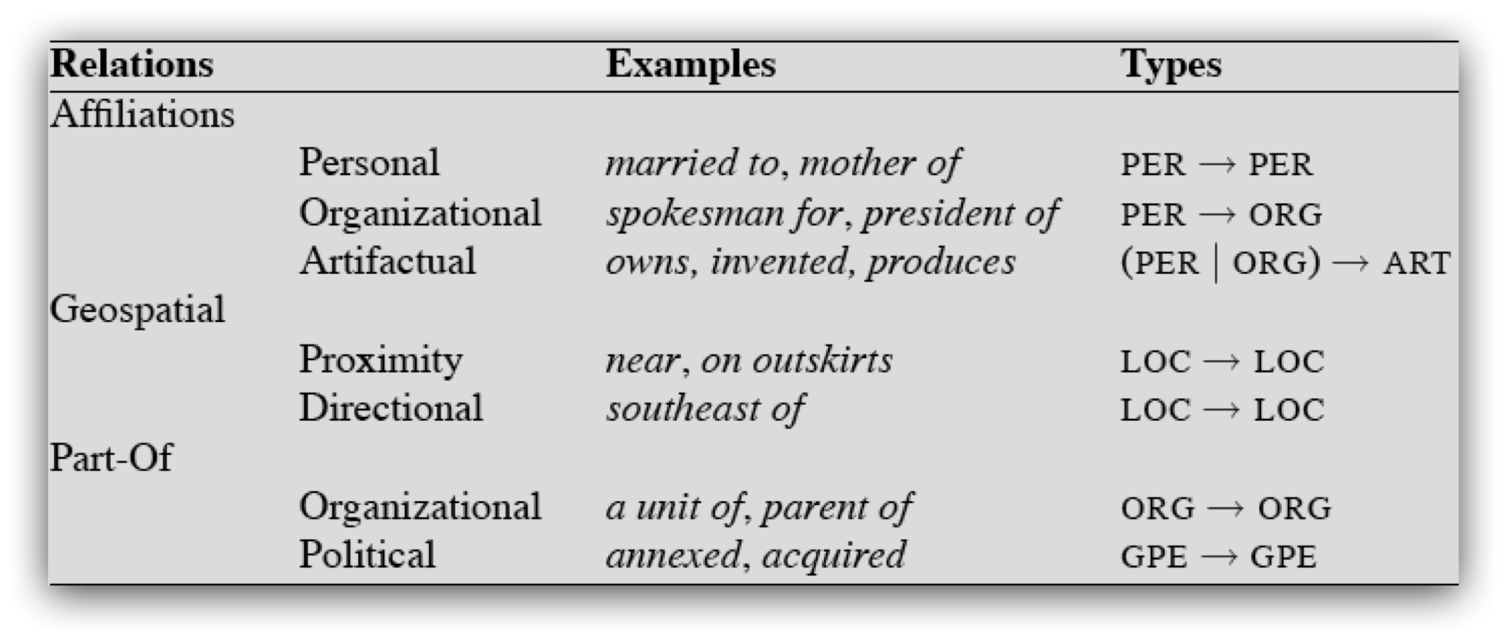
Relation Types
As with named entities, the list of relations is application specific. For generic news texts...

Slide 41
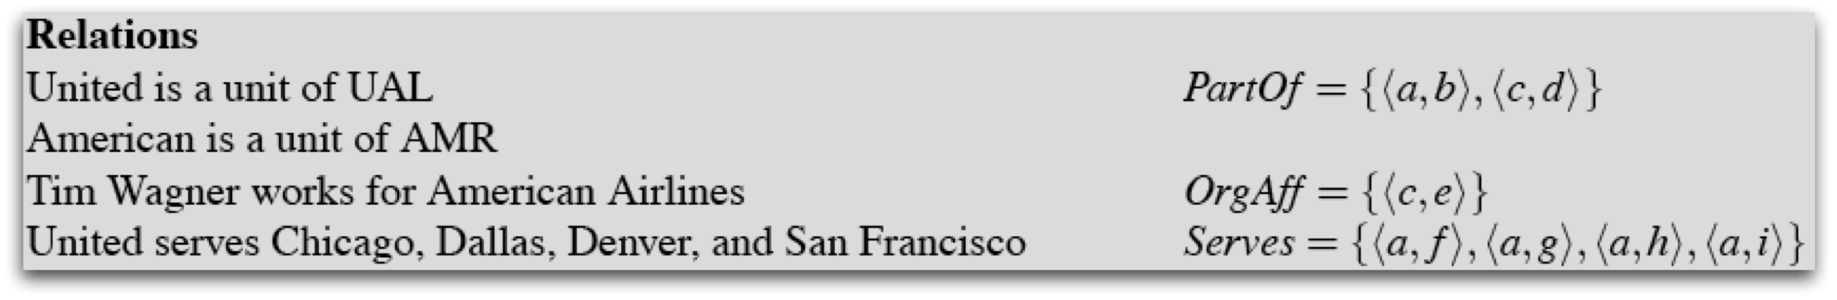
Relations
By relation we really mean sets of tuples.
Think about populating a database.

Slide 42
Information Extraction
CHICAGO (AP) — Citing high fuel prices, United Airlines said Friday it has increased fares by $6 per round trip on flights to some cities also served by lower-cost carriers. American Airlines, a unit AMR, immediately matched the move, spokesman Tim Wagner said. United, a unit of UAL, said the increase took effect Thursday night and applies to most routes where it competes against discount carriers, such as Chicago to Dallas and Atlanta and Denver to San Francisco, Los Angeles and New York
Relation | Arg 1 | Arg 2
PartOf | United | UAL
PartOf | American | AMR
EmployedBy | Tim Wagner | American

Slide 43
Relation Analysis
We can divide relation analysis into two parts
Determining if 2 entities are related
And if they are, classifying the relation
There are 2 reasons to do this
Cutting down on training time for classification by eliminating most pairs
Producing separate feature-sets that are appropriate for each task.

Slide 44
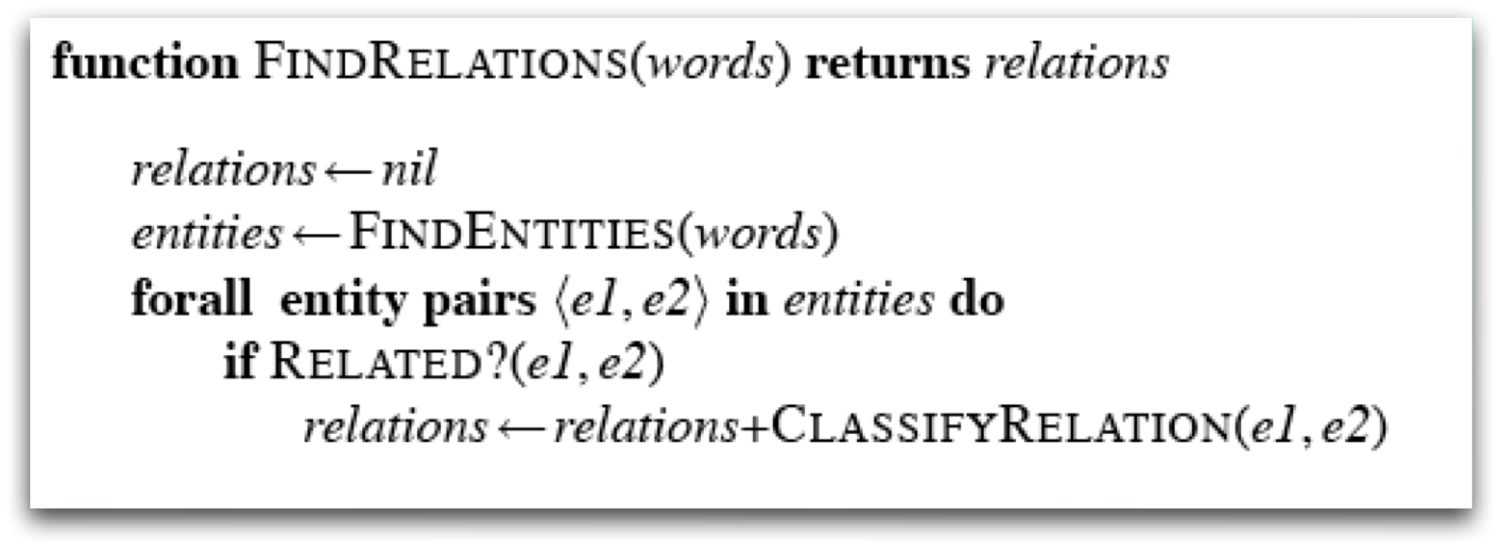
Relation Analysis
Let’s just worry about named entities within the same sentence

Slide 45
Features
We can group the features (for both tasks) into three categories
Features of the named entities involved
Features derived from the words between and around the named entities
Features derived from the syntactic environment that governs the two entities

Slide 46
Features
Features of the entities
Their types
Concatenation of the types
Headwords of the entities
George Washington Bridge
Words in the entities
Features between and around
Particular positions to the left and right of the entities
+/- 1, 2, 3
Bag of words between

Slide 47
Features
Syntactic environment
Constituent path through the tree from one to the other
Base syntactic chunk sequence from one to the other
Dependency path

Slide 48
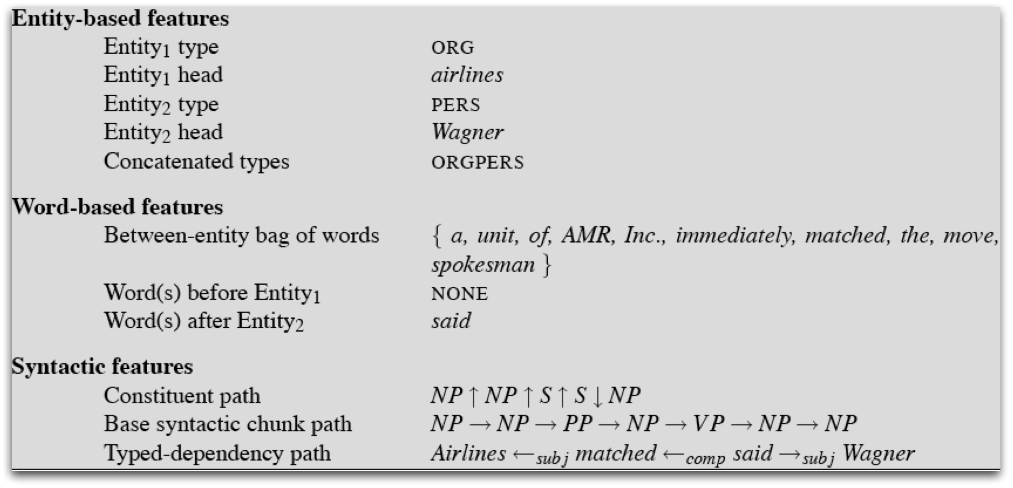
Example
For the following example, we’re interested in the possible relation between American Airlines and Tim Wagner.
American Airlines, a unit AMR, immediately matched the move, spokesman Tim Wagner said.

Slide 49
Caveat
Academics and researchers focus on ML methods
But practical applications aren’t monolithic classifiers
Multiple resources: dictionaries, gazeteers, stop-lists, etc.
Multiple passes: high precision rules first
Copious use of Perl

Slide 50
Bioinformatics
An example domain
Very important: basic science, clinical practice, insurance billing, etc.
Practitioners care about the technology
They have problems they’re trying to solve
Lots and lots of text available
Lots of interesting problems

Slide 51
Bio NER
Large number of fairly specific types
Wide (really quite insane) variation in the naming of entities
Gene names
White, insulin, BRCA1, ether a go-go, breast cancer associated 1, etc.

Slide 52
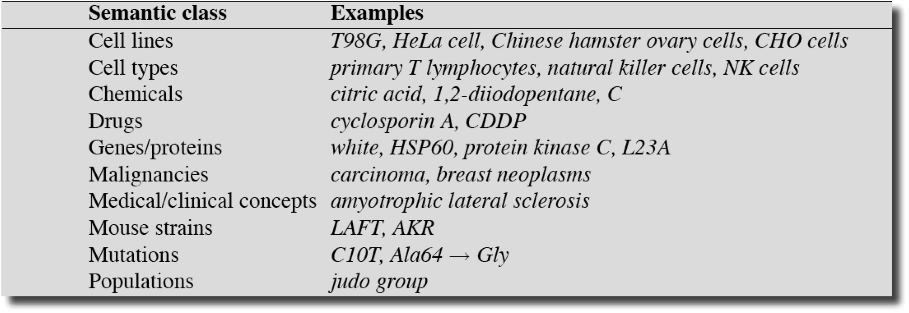
Bio NER Types

Slide 53
Summary
Information extraction makes use of loosely coupled systems to extract shallow semantic elements from texts
Must exploit domain dependent features to get state of the art performance
Current research focused on less objective characteristics of text
sentiment, opinion, deception, bias, motivation, predatory intent, etc.

